Slide 1
Twitter sentiment analysis on Crypto Currency
- Can Twitter be used as an indicator on crypto currency value and fluctuation?
Notes:
Why this q?
Seemed like a good way to test our new earned skills

Slide 2
Can Twitter be used as an indicator on crypto currency value and fluctuation?
Do not really have an answer to that!
Notes:
Twitter sentiment analysis:
Easy and naive model:
Comparing fluctuation with sentiment score (the day before)
A lot of problems with this (more to come)
The analysis would have to run all tweets for far longer than a month to surely state any basis
With all tweets (big data)
Volume of twitter messages ….
Gather BitCoin data:
CC very volatile
Through API cryptocompare.com → csv etc.
Merge dataframes
Make analysis
Correlation coefficient?
Warning! No result is also a result!!!!

Slide 3
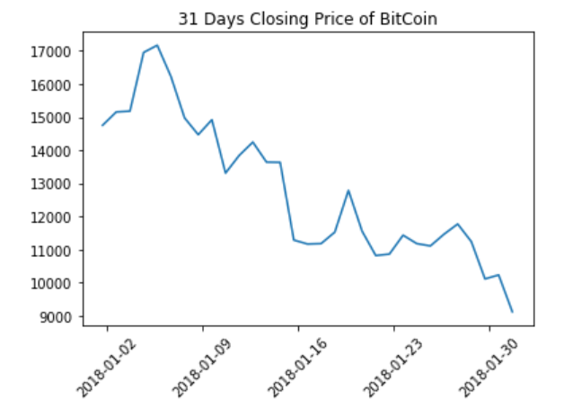
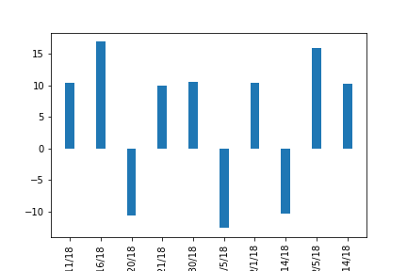
BitCoin
BitCoin total market cap approx. 45%
Highly volatile

Slide 4
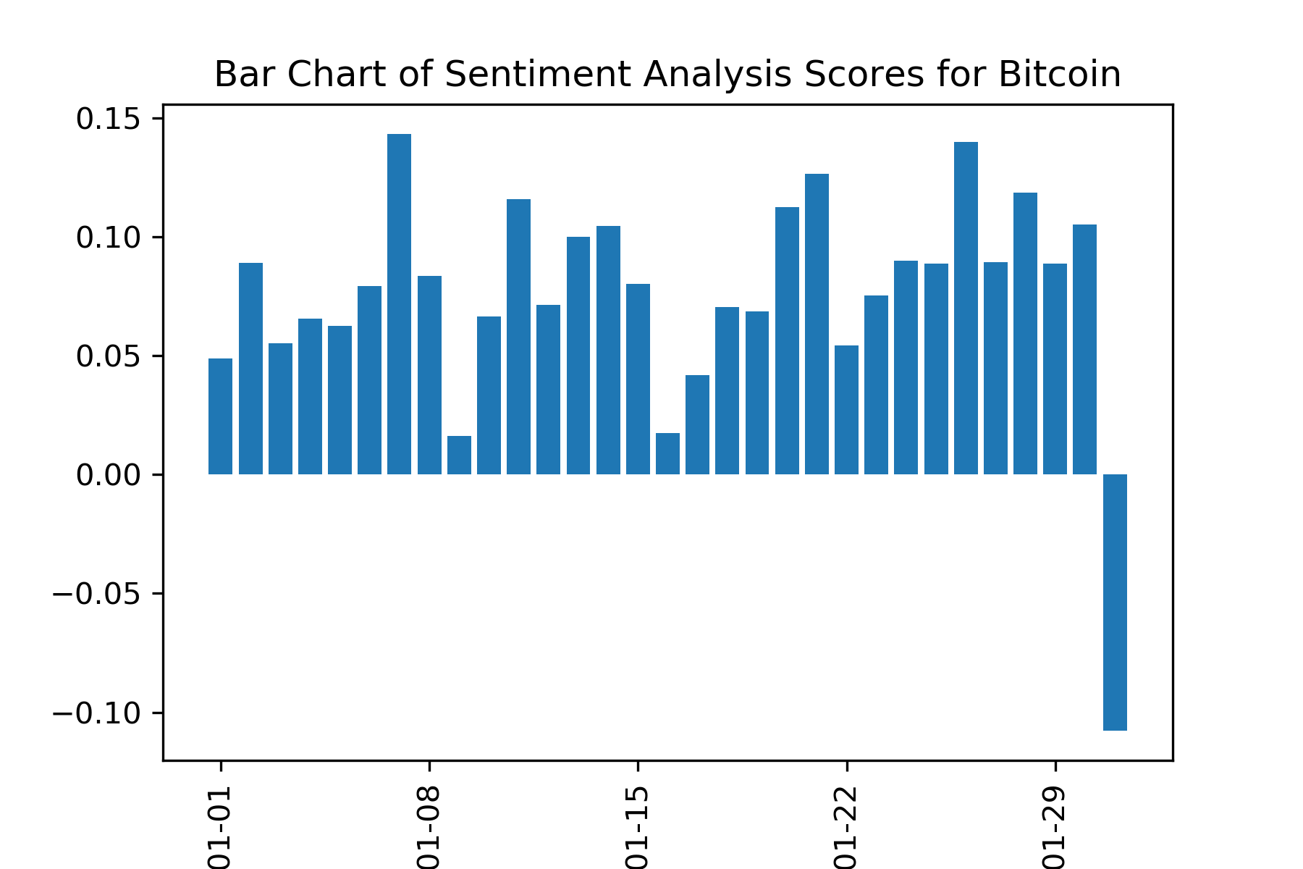
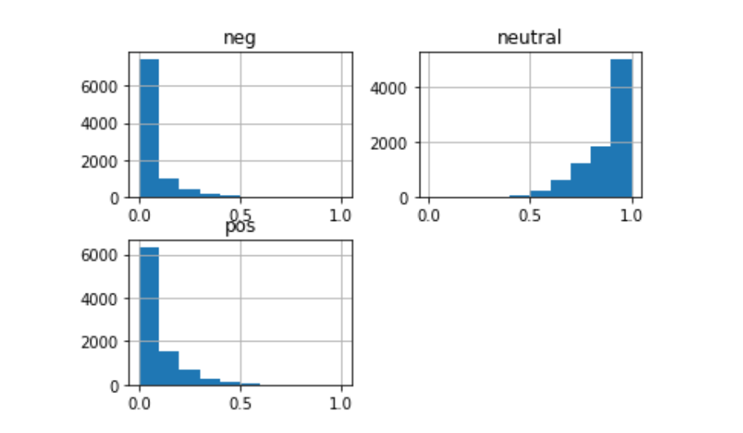
Sentiment Analysis

Slide 5
Correlation Coefficient
0,016
Notes:
Other currencies
Influencers/experts
Detailed analysis days → hours
the analysis would have to run for far longer than a month to surely state any basis
The primary conclusion is that the number of predictions were
so few that venturing into prediction model conclusions would be un-
founded.
Further improvements of the analysis would identify financial and cryptocurrency terms and yield a more
representative sentiment, hopefully improving the prediction accuracy

Slide 6
Twitter Sentiment Analysis
Plan for your project presentations to be 10 minutes in length.Don’t forget to describe your research questions and hypotheses.
Describe what motivated you to conduct the research that you delved into. Why are you doing this?
Describe the EDA and cleanup process.
Describe any major challenges you had.
Describe your findings. How did you arrive at your conclusions. What irrefutable evidence do you have that will crush all of your critics and enemies?Discuss the big picture implications of your findings. What does it all mean, man?
What did you learn during this process, in general? (edited)Tell a good story. Humor is welcome, but no more than 7 giphies are allowed.

